Slide 1
Solution as a Code czyli sposób na to, jak skutecznie walczyć z boilerplate code i nie tylko…

Slide 2

O mnie
Developer
embbeded
frontend
backend
trochę Architekt
trochę TechLead
prawie DevOps
Email/Slack:
marekseweryn.progmark@gmail.com
LinkedIn:
https://www.linkedin.com/in/marekseweryn/
GitHub:
https://github.com/ProgMark

Slide 3
Solution as a Code czyli sposób na to, jak skutecznie walczyć z boilerplate code i nie tylko…

Slide 4
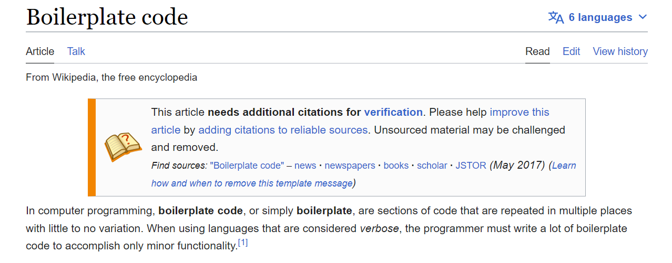
https://en.wikipedia.org/wiki/Boilerplate_code

Slide 5

monolits
microservices
modular monolit
https://www.flaticon.com/

Slide 6
monolits
Architektura
Infrastruktura
Narzędzia
Obowiązujące zasady i reguły
microservices
modular monolit
https://www.flaticon.com/

Slide 7
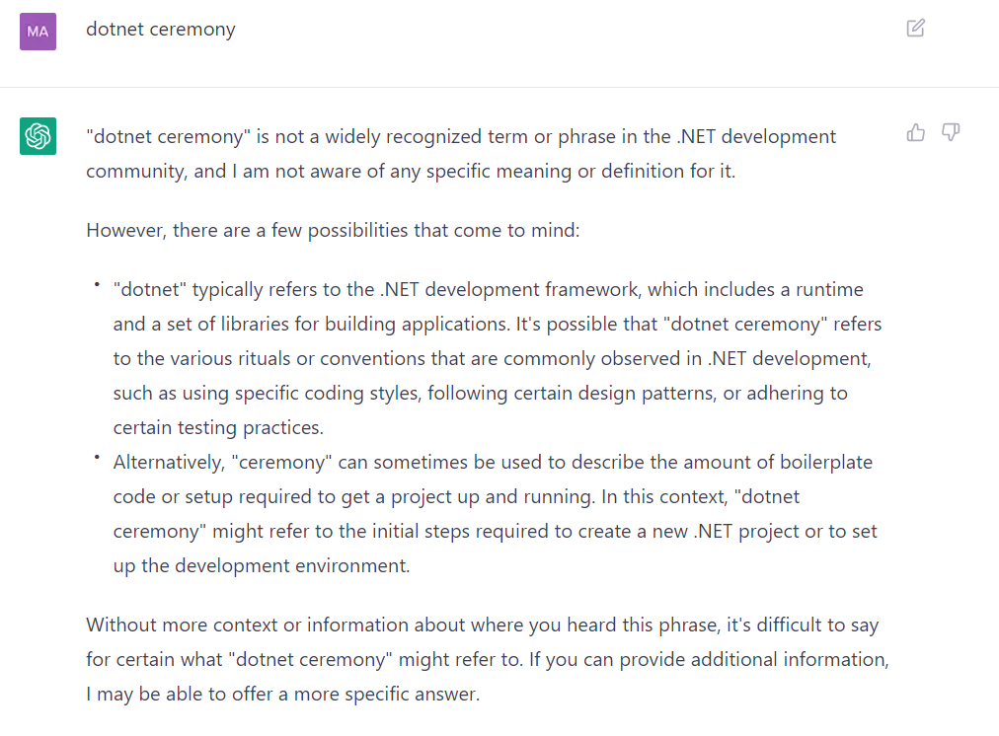
https://chat.openai.com/chat

Slide 8
blic record GetProductByIdQuery(int Id) : IRequest<Product>;
public class GetProductByIdQueryValidator : AbstractValidator<GetProductByIdQuery>
{
public GetProductByIdQueryValidator()
{
GRuleFor(x=>x.Id).GraterThan(0);
}
}
public class GetProductByIdQueryHandler : IRequestHandler<GetProductByIdQuery, Product>
{
private readonly FakeDataStore _fakeDataStore;
public GetProductByIdQueryHandler(FakeDataStore fakeDataStore) =>
_fakeDataStore = fakeDataStore;
public async Task<Product> Handle(GetProductByIdQuery request, CancellationToken cancellationToken) =>
await _fakeDataStore.GetProductById(request.Id);
}

Slide 9
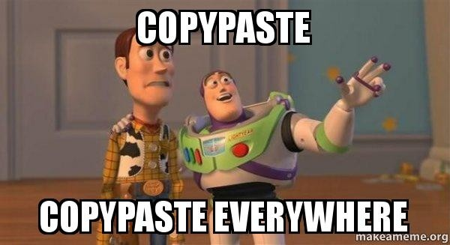

Slide 10
architecture complexity
monolit
microservices
modular monolit
amount of boilerplate code and ceremony

Slide 11

https://www.pngegg.com/en/png-ydvgx

Slide 12
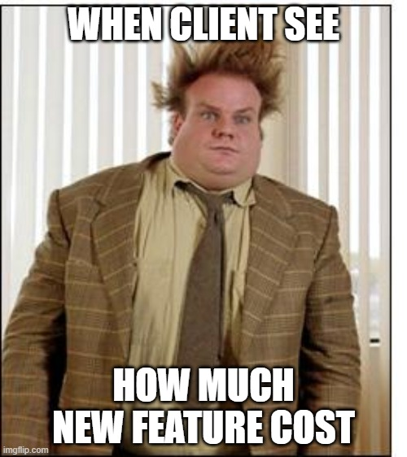

Slide 13

https://tenor.com/pl/search/blow-mind-gifs

Slide 14
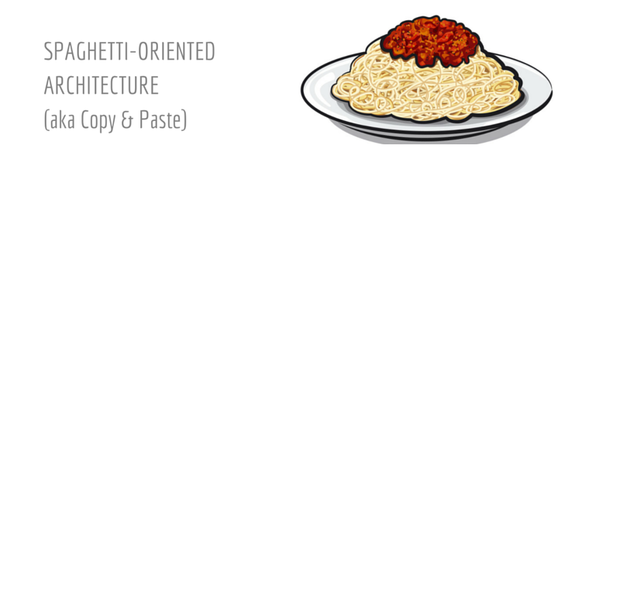
By @benorama

Slide 15
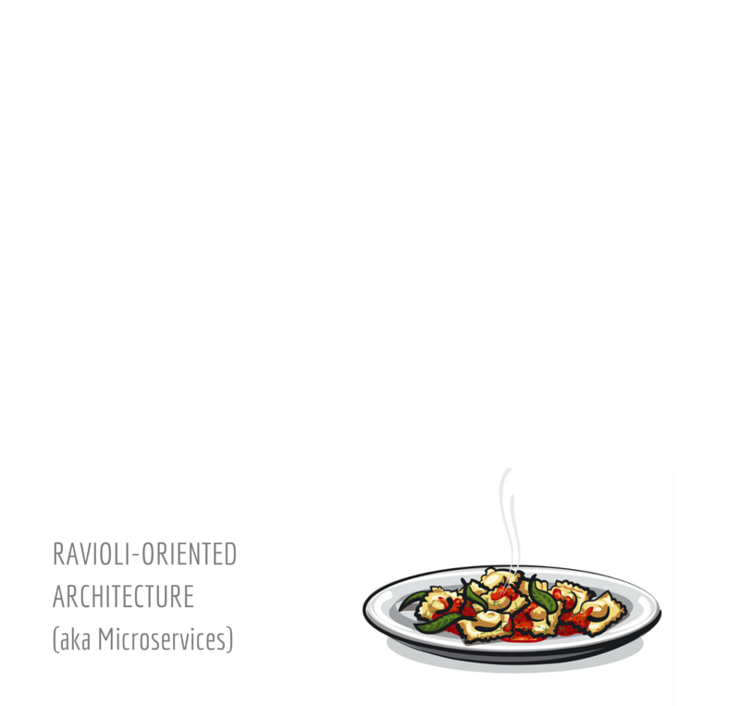
By @benorama
By @benorama

Slide 16
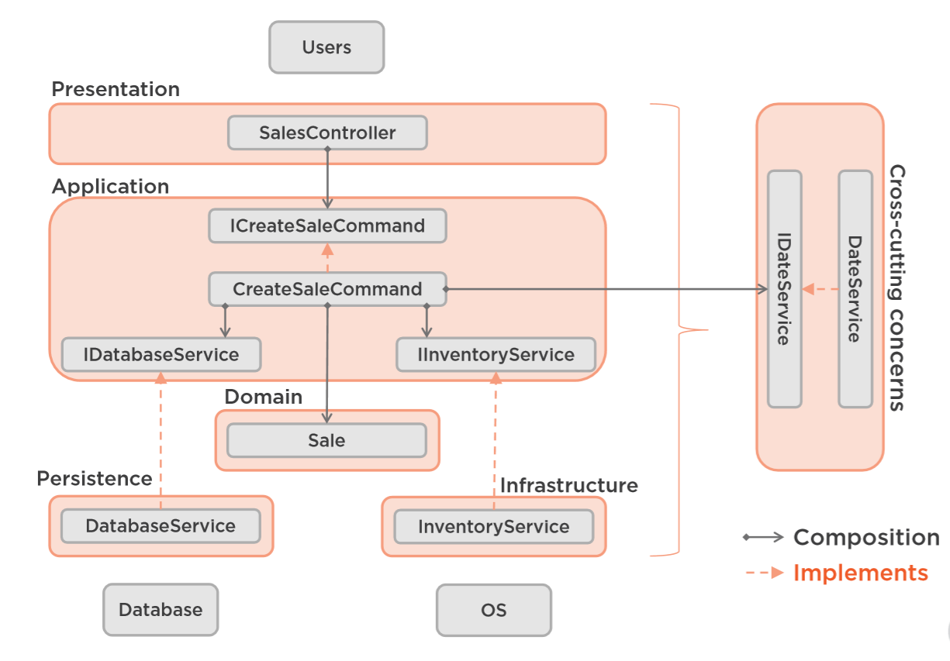
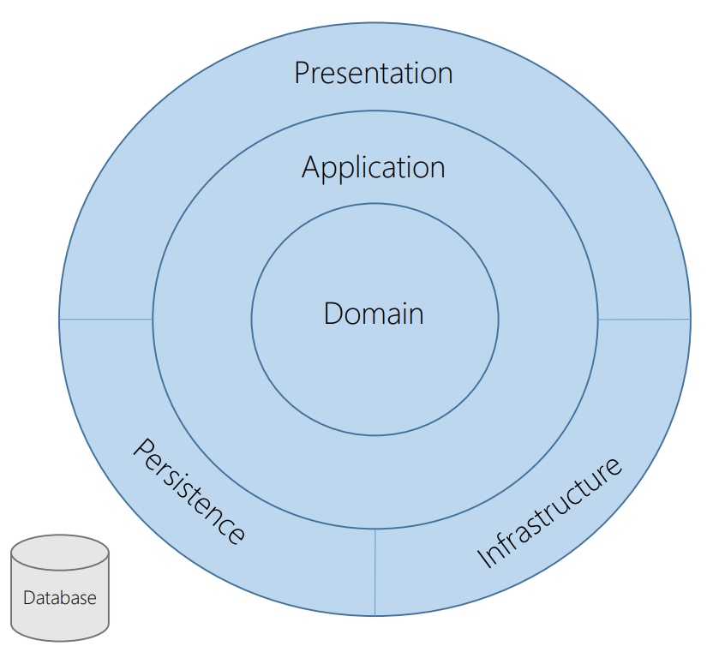
onion architecture
https://matthewrenze.com/presentations/clean-architecture/

Slide 17

https://knowyourmeme.com/memes/pablo-escobar-waiting

Slide 18
… as a code

Slide 19





documentation as a code
IaaC – infrastructure as a code
… as a code
pipelines as a code
SaaC – security as a code
diagrams as a code

Slide 20

documentation as a code
IaaC – infrastructure as a code
… as a code
pipelines as a code
SaaC – security as a code
diagrams as a code
https://www.flaticon.com/
solution as a code

Slide 21

custom templates
dotnet tool
+
=

Slide 22
custom templates
dotnet tool
+
Niski próg wejścia
Prostota implementacji i utrzymania
Niezależność od IDE oraz OS
Łatwość dystrybucji i instalacji
=

Slide 23
DEMO

Slide 24

https://tenor.com/pl/search/magic-shia-labeouf-gifs

Slide 25







standaryzacja
microservices
modular monolit
poc project
pet project
https://www.flaticon.com/

